Slide 1
Department of Computer Science and Engineering (CSE)
INSTITUTE : UIE
DEPARTMENT : CSE
Bachelor of Engineering (Computer Science & Engineering)
Disruptive Technologies-3
(23CSH-203)
Overview of Databases
DISCOVER . LEARN . EMPOWER

Slide 2
Department of Computer Science and Engineering (CSE)
COURSE OBJECTIVES:
The course aims to provide exposure to understand Information Security basics like Operating System Security, Network Security, Software Security and Web Security.
The course aims to provide basics of cloud computing along with virtualization, cloud computing is one of the fastest growing domains from a while now. It will provide the students basic understanding about cloud and virtualization along with it how one can migrate over it
The Course aim to state core blockchain concepts, the benefits, and the limitations of blockchain technologies

Slide 3
Department of Computer Science and Engineering (CSE)
CO No | Statement
CO1 | Remember the concepts related to fundamentals of Information Security, Cloud Computing and Block Chain.
CO2 | Understand the way to find, understand and Analyse the Problem for Errors, Attack memory Virtualization and Basic Block chain Techniques.
CO3 | Apply various method to avoid Security Leakage, Data Storage on cloud and working methods of Block Chain.
CO4 | Analyse the Basic tools of Information Security, Cloud Computing and Blockchain and implementation with reports generation.
CO5 | Design and develop customized reports on attacks, Online memory allocation , security using blockchain

Slide 4
Contents of the Syllabus
Department of Computer Science and Engineering (CSE)
UNIT-1 | INTRODUCTION TO BASIC OF INFORMATION SECURITY | Contact Hours:10
Introduction to Security, Attacks and its Understanding | Introduction Security, Attacks, Computer Crime, Security Services, Security Mechanism, Cyber Crime, Information Technology ACT.
Fundamental of Ciphers | Cryptography, Substitution Ciphers, Transpositions Ciphers, Block Ciphers, Stream Ciphers,
Precautions and Preventions of Cyber Crime. | Cyber Crimes, Types of Cyber Crime, Social Media Precautions, Prevention of Cyber Crime and Basic precautions. Basic of Ethical Hacking.
UNIT-2 | CLOUD COMPUTING AND DATA VIRTUALIZATION |  | Contact Hours:10
Cloud Computing Overview | Origins of Cloud computing – Cloud components - Essential characteristics – On-demand selfservice, Broad network access, Location independent resource pooling ,Rapid elasticity , Measured service, Comparing cloud providers with traditional IT service providers, Roots of cloud computing
Cloud Insights | Architectural influences – High-performance computing, Utility and Enterprise grid computing, Cloud scenarios – Benefits: scalability, simplicity, vendors, security, Limitations – Sensitive information
Cloud Applications | Application development- security level of third party - security benefits, Regularity issues: Government policies

Slide 5
Contents of the Syllabus
Department of Computer Science and Engineering (CSE)
UNIT-3 | BLOCK CHAIN AND CRYPTOCURRENCY
Introduction to Block Chain and Cryptocurrency | Blockchain Overview History and Origin of Blockchain (and Cryptocurrency) Start of Technical Concepts of Blockchain Systems, Importance, Applications, Benefits and features of Block Chain Technology.
Components and Working of Block Chain | Key component and working of Block Chain Technology, Types of Block Chain Networks and protocols
Bitcoin and block Chain. | Bitcoin network, Bitcoin Mining, Differentiate between database, cloud and Blockchain, Block Chain Services, Introduction to AWS server and Virtual Machines

Slide 6
Cryptography
Department of Computer Science and Engineering (CSE)
Cryptography is the study and practice of techniques for secure communication in the presence of third parties called adversaries. It deals with developing and analyzing protocols that prevents malicious third parties from retrieving information being shared between two entities thereby following the various aspects of information security. Secure Communication refers to the scenario where the message or data shared between two parties can’t be accessed by an adversary. In Cryptography, an Adversary is a malicious entity, which aims to retrieve precious information or data thereby undermining the principles of information security. Data Confidentiality, Data Integrity, Authentication and Non-repudiation are core principles of modern-day cryptography.
Confidentiality refers to certain rules and guidelines usually executed under confidentiality agreements which ensure that the information is restricted to certain people or places.
Data integrity refers to maintaining and making sure that the data stays accurate and consistent over its entire life cycle.
Authentication is the process of making sure that the piece of data being claimed by the user belongs to it.
Non-repudiation refers to the ability to make sure that a person or a party associated with a contract or a communication cannot deny the authenticity of their signature over their document or the sending of a message.
University Institute of Engineering (UIE

Slide 7
Cryptography
Department of Computer Science and Engineering (CSE)
Consider two parties Alice and Bob. Now, Alice wants to send a message m to Bob over a secure channel. So, what happens is as follows. The sender’s message or sometimes called the Plaintext, is converted into an unreadable form using a Key k. The resultant text obtained is called the Ciphertext. This process is known as Encryption. At the time of received, the Ciphertext is converted back into the plaintext using the same Key k, so that it can be read by the receiver. This process is known as Decryption.
Alice (Sender) Bob (Receiver)
C = E (m, k) ----> m = D (C, k)
Here, C refers to the Ciphertext while E and D are the Encryption and Decryption algorithms respectively. Let’s consider the case of Caesar Cipher or Shift Cipher as an example. As the name suggests, in Caesar’s Cipher each character in a word is replaced by another character under some defined rules. Thus, if A is replaced by D, B by E and so on. Then, each character in the word would be shifted by a position of 3. For example:
Plaintext : Geeksforgeeks
Ciphertext : Jhhnvirujhhnv

Slide 8
Types of Cryptography:
Department of Computer Science and Engineering (CSE)
There are several types of cryptography, each with its own unique features and applications. Some of the most common types of cryptography include:
1. Symmetric-key cryptography: This type of cryptography involves the use of a single key to encrypt and decrypt data. Both the sender and receiver use the same key, which must be kept secret to maintain the security of the communication.
2. Asymmetric-key cryptography: Asymmetric-key cryptography, also known as public-key cryptography, uses a pair of keys – a public key and a private key – to encrypt and decrypt data. The public key is available to anyone, while the private key is kept secret by the owner.
Hash functions: A hash function is a mathematical algorithm that converts data of any size into a fixed-size output. Hash functions are often used to verify the integrity of data and ensure that it has not been tampered with.

Slide 9
Applications of Cryptography:
Department of Computer Science and Engineering (CSE)
Cryptography has a wide range of applications in modern-day communication, including:
Secure online transactions: Cryptography is used to secure online transactions, such as online banking and e-commerce, by encrypting sensitive data and protecting it from unauthorized access.
Digital signatures: Digital signatures are used to verify the authenticity and integrity of digital documents and ensure that they have not been tampered with.
Password protection: Passwords are often encrypted using cryptographic algorithms to protect them from being stolen or intercepted.
Military and intelligence applications: Cryptography is widely used in military and intelligence applications to protect classified information and communications.

Slide 10
Challenges of Cryptography:
Department of Computer Science and Engineering (CSE)
While cryptography is a powerful tool for securing information, it also presents several challenges, including:
Key management: Cryptography relies on the use of keys, which must be managed carefully to maintain the security of the communication.
Quantum computing: The development of quantum computing poses a potential threat to current cryptographic algorithms, which may become vulnerable to attacks.
Human error: Cryptography is only as strong as its weakest link, and human error can easily compromise the security of a communication.

Slide 11
Substitution Cipher
Department of Computer Science and Engineering (CSE)
Hiding some data is known as encryption. When plain text is encrypted it becomes unreadable and is known as ciphertext. In a Substitution cipher, any character of plain text from the given fixed set of characters is substituted by some other character from the same set depending on a key. For example with a shift of 1, A would be replaced by B, B would become C, and so on.
Note: Special case of Substitution cipher is known as Caesar cipher where the key is taken as 3.
Mathematical representation
The encryption can be represented using modular arithmetic by first transforming the letters into numbers, according to the scheme, A = 0, B = 1,…, Z = 25. Encryption of a letter by a shift n can be described mathematically as.
En(x) = (x+n)mod 26
Dn(x) = (x-n)mod 26

Slide 12
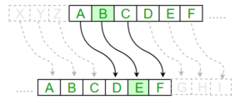
Substitution Cipher
Department of Computer Science and Engineering (CSE)
Examples:
Plain Text: I am studying Data EncryptionKey: 4Output: M eq wxyhCmrk Hexe IrgvCtxmsrPlain Text: ABCDEFGHIJKLMNOPQRSTUVWXYZKey: 4Output: EFGHIJKLMNOPQRSTUVWXYZabcd

Slide 13
Department of Computer Science and Engineering (CSE)
Algorithm for Substitution Cipher:
Input:
A String of both lower and upper case letters, called PlainText.
An Integer denoting the required key.
Procedure:
Create a list of all the characters.
Create a dictionary to store the substitution for all characters.
For each character, transform the given character as per the rule, depending on whether we’re encrypting or decrypting the text.
Print the new string generated.

Slide 14
Transposition Cipher Techniques in Cryptography
Department of Computer Science and Engineering (CSE)
The Transposition Cipher Technique is an encryption method used to encrypt a message or information. This encryption method is done by playing with the position of letters of the plain text. The positions of the characters present in the plaintext are rearranged or shifted to form the ciphertext. It makes use of some kind of permutation function to achieve the encryption purpose. It is very easy to use and so simple to implement.
Types of Transposition Cipher Techniques
There are three types of transposition cipher techniques
Rail Fence Transposition Cipher
Block (Single Columnar) Transposition Cipher
Double Columnar Transposition Cipher
Rail Fence Transposition Cipher
Rail Fence Transposition cipher technique is the simplest transposition cipher techniqueits. It is also termed as a zigzag cipher. It gets it’s name from the way through which it performs encryption of plain text.

Slide 15
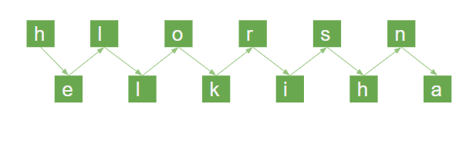
Department of Computer Science and Engineering (CSE)
The steps to get cipher text with the help of the Rail Fence Transposition cipher technique are follows:-
Technique of Rail Fence Transposition Cipher
Example: The plain text is “Hello Krishna”
Now, we will write this plain text in the diagonal form:

Slide 16
Transposition Cipher Techniques in Cryptography
Department of Computer Science and Engineering (CSE)
Now, following the second step we get our cipher text
Cipher Text = “rsnelkiha”
Block (Single Columnar) Transposition Cipher
Block Transposition Cipher is another form of Transposition Cipher which was used to encrypt the message or information. In this technique, first, we write the message or plaintext in rows. After that, we read the message column by column. In this technique, we use a keyword to determine the no of rows.
Step 1: First we write the message in the form of rows and columns, and read the message column by column.
Step 2: Given a keyword, which we will use to fix the number of rows.
Step 3: If any space is spared, it is filled with null or left blank or in by (_).
Step 4: The message is read in the order as specified by the keyword.

Slide 17
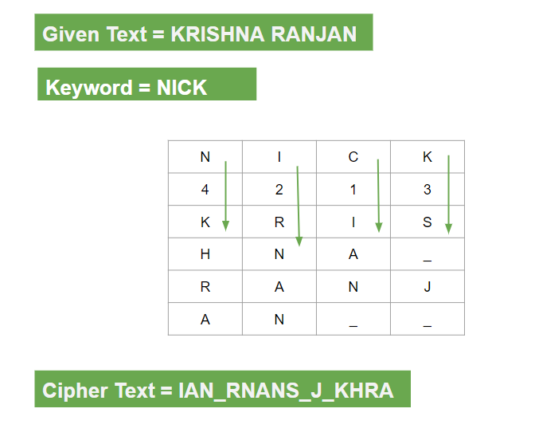
Department of Computer Science and Engineering (CSE)

Slide 18
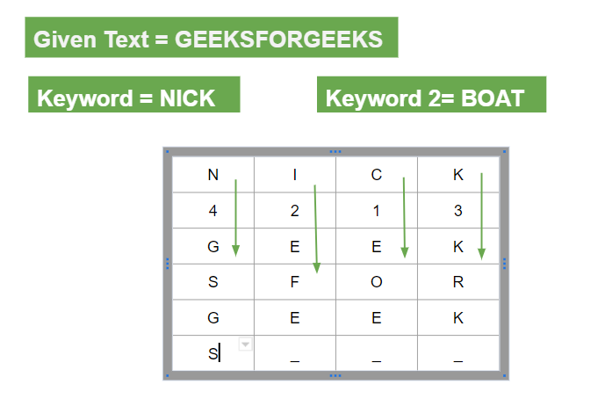
Department of Computer Science and Engineering (CSE)
For example: The plaintext is “KRISHNA RANJAN”
Now we will write the plaintext in the form of row and column.
Cipher Text = IAN_RNANS_J_KHRA
Double Columnar Transposition Cipher
Double Columnar Transposition Cipher is another form of Transposition Cipher Technique. It is just similar to the columnar transposition technique. The main objective of using a Double Columnar Transposition Cipher is to encrypt the message twice. It makes use of the Single Columnar Transposition technique but uses two times. It can use the same or different secret keys. The output obtained from the first encryption will be the input to the second encryption.
Step 1: First we write the message in the form of rows and columns, and read the message column by column.
Step 2: Given a keyword, which we will use to fix the number of rows.

Slide 19
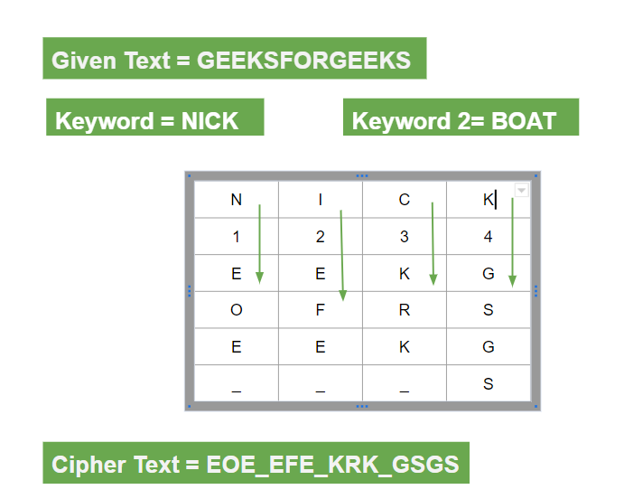
Department of Computer Science and Engineering (CSE)
Step 3: If any space is spared, it is filled with null or left blank or in by (_).
Now applying keyword 2
Step 4: The message is read in the order in by the keyword.
Now applying step 3:

Slide 20
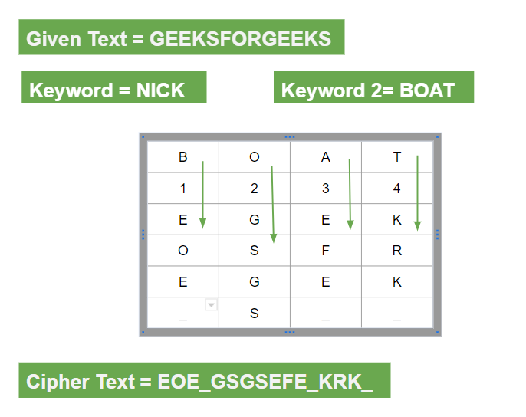
Department of Computer Science and Engineering (CSE)
Step 5: Then the output from the first encryption is input to the second.
Step 6: Now the message is read in Technique in the order specified by the second keyword.
The Cipher Text is: “S_J_IAN_RNANKHRA”

Slide 21
References
Department of Computer Science and Engineering (CSE)
TEXT BOOKS/REFERENCE BOOKS
TEXT BOOKS
T1 Introduction to Cyber Security by Shimeall , Elsevier Science, 2nd Edition, 2017.
T2Introduction To Information Security And Cyber Laws by Surya Prakash Tripathi and Ritendra, John Wiley
, 2010.
REFERENCE BOOKS
R1Principles of Information Security, By Michael E. Whiteman. Cengage Learning, 2015
R2.Information Technology SecurityFundamentals, by Glen Sagar, Business Expert Press, 2022
R3Information Security Policies And Procedures: A Practitioners Reference 2Nd Edition by Peltier Thomas R., T&F India, 2004

Slide 22



Department of Computer Science and Engineering (CSE)

